Slide 1
start
vending
machine
done
In(0/1)
product
clock
reset
change
Coins($)
Chocolate :0
Drink :1
Coins($) : 0,1, 2, 5

Slide 2
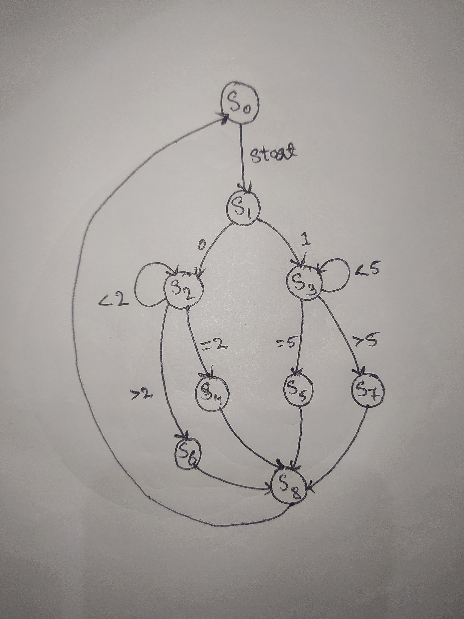

Slide 3
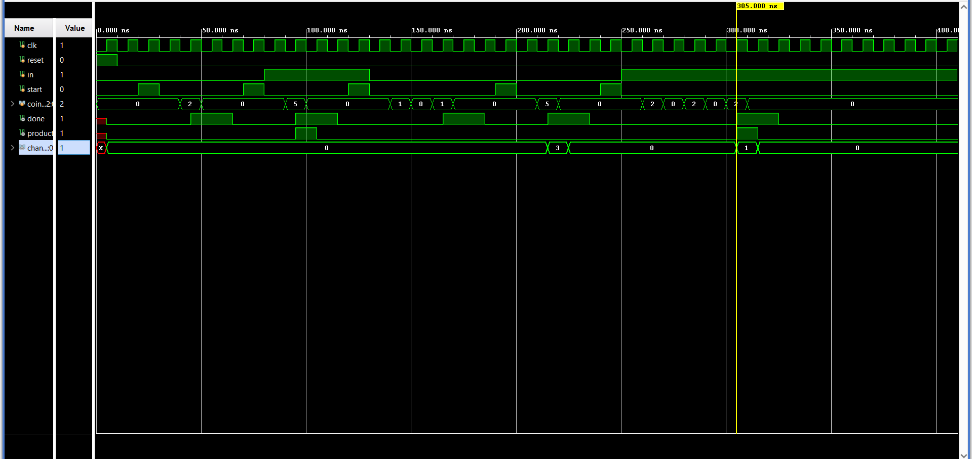

Slide 4
